Slide 1

Airbnb Occupancy and Revenue Analytics
Los Angeles County
Group ~ 2
Jill Karia
Advait Narvekar
Soundarya Ravi
Punami Chowdary

Slide 2

Introduction
Airbnb Prediction focuses on analyzing data related to rental prices and occupancy rates across various listings. This involves evaluating factors like local crime rates, transportation access, and property amenities, ultimately guiding hosts to optimize their listings for better revenue generation.
Notes:
what is your domain problem, who is your stakeholder? Please clarify the need you are addressing, and how you know that this is a need.
This model can help facilitate more sustainable lending practices for organizations like the World Bank or IMF. Additionally, our model can also be used by the government institutions of the country or the policy makers to make better decisions regarding external borrowing and monitoring the ongoing debt. Our model can also be used by NGOs to help them target their interventions by identifying the root cause of the problem.

Slide 3
Data
Airbnb
Crime
Public Transport
Aggregated total number of crimes per zip code
Aggregated total number of bus stops and metro stops per zip code
Notes:
Mention that we merged on zipcode

Slide 4
Feature Engineering
Amenities - grouped the similar amenities together, added super categories, summed up and then encoded them.
Property type - group similar property types encoded the property types.
Datetime columns - changed date time columns to numeric columns by counting the days since that date.
Room Types - encoded the 4 room types.
Bathroom count - Took shared bathrooms as 0.5 bathroom and private bathroom or nothing mentioned as 1 bathroom/
Host response time - Used cardinality to do label encoding
Imputed columns like days since last review where the value does not exist as -1 to mask it
Imputed zero to columns where nulls are supposed to mean 0
When needed to impute mean we imputed it as mean grouping listings by zip code to make sure the location is taken care of
For price column to deal with outliers log transformed the column

Slide 5
Important Features
Price
Occupancy
Weapons-Related Crimes
Host ID
Superhost Status
Free Wi-Fi and Internet
Number of Reviews
Safety Features
Swimming Amenities
Kitchen Essentials
Family-Friendly Amenities
Number of Bathrooms
Years as Host
Host Acceptance Rate
Total Listings Owned by Host
Average Minimum Nights Required
Host Response Time
Time Since Last Review
Total Amenities Offered
Private Room Listings by Host
Host Response Rate

Slide 6
R Squared Value
Linear Regression
Random Forest
GBT
Price: 52.97
Occupancy: 89.99
Price: 63.66
Occupancy: 91.61
Price: 77.07
Occupancy: 91.5

Slide 7
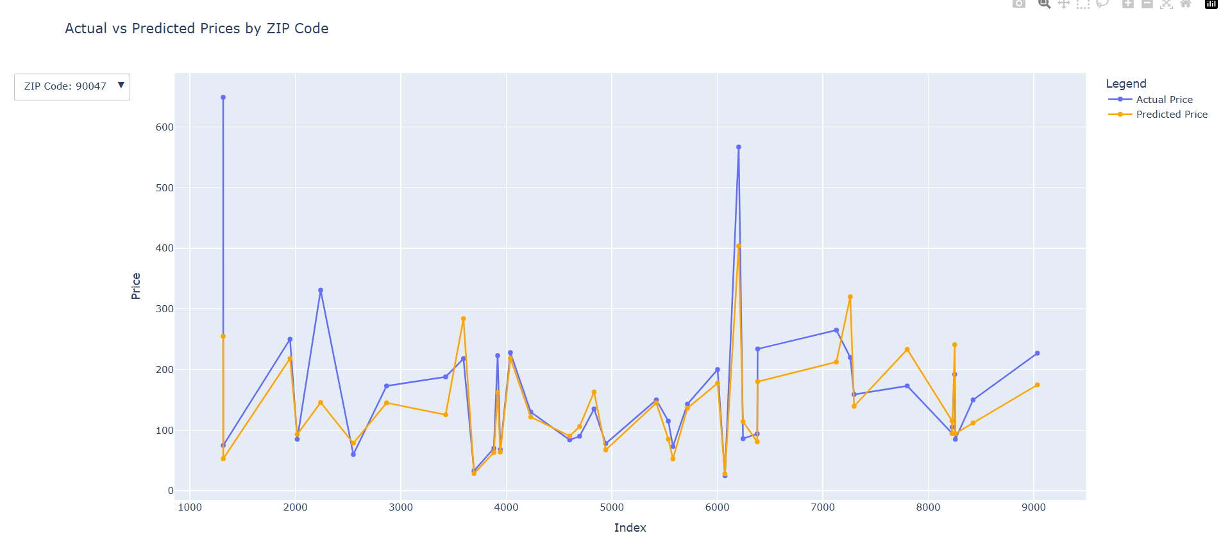
Current results (Price)
77.07
R Squared value
Notes:
This is the key slide - where do you stand right now with results? If you don't have results, you should explain why not and what you are going to do about it.

Slide 8
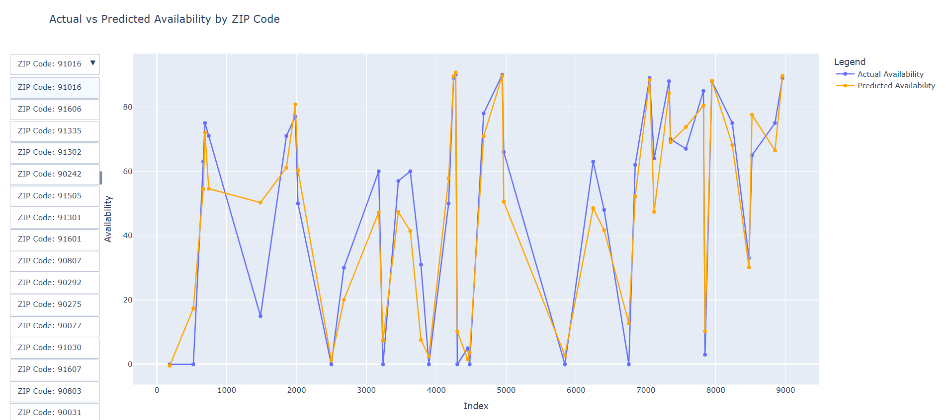
Current results (Availability)
91.5
R Squared Value
Notes:
This is the key slide - where do you stand right now with results? If you don't have results, you should explain why not and what you are going to do about it.

Slide 9
Stakeholder Metrics
Revenue prediction
Pricing insights
Location Recommendation
Best Amenities
Property type Recommendation

Slide 10
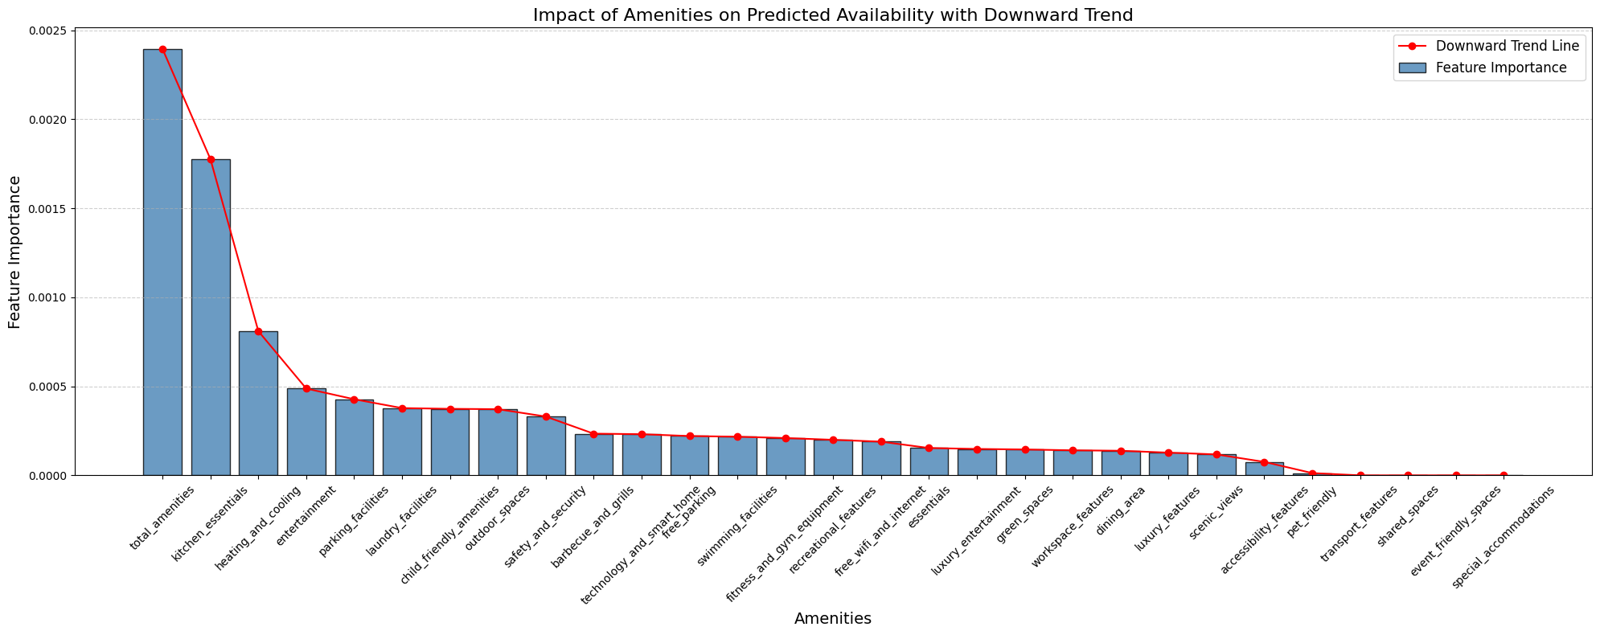
Stakeholder Metrics: Best amenities
To measure how different amenities impact occupancy rates, helping stakeholders prioritize features that drive bookings.

Slide 11
Stakeholder Metrics: Revenue Prediction
Use price and occupancy predictions to forecast the host’s revenue for the upcoming year
This can enable hosts to make more informed decisions on future investments, repairs and planning
Hosts can also use these revenue to forecasts to price their Airbnbs appropriately

Slide 12
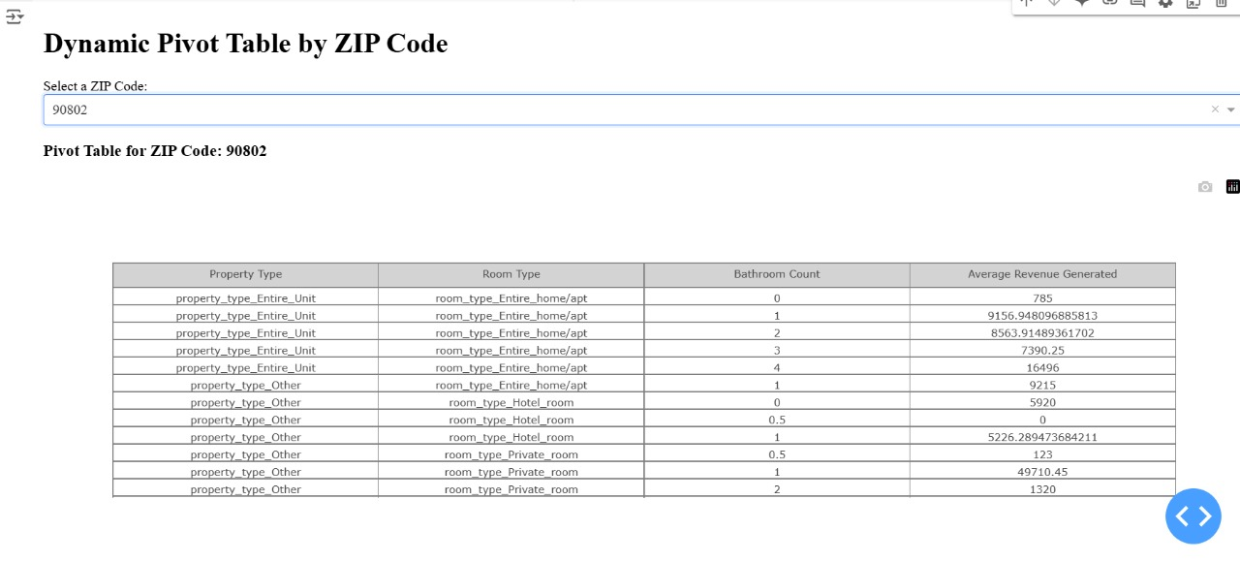

Slide 13
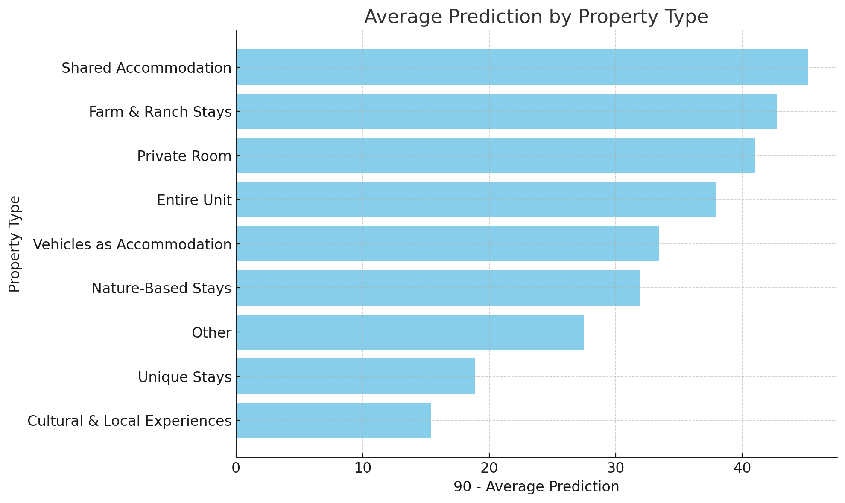
Airbnbs with the highest occupancy

Slide 14
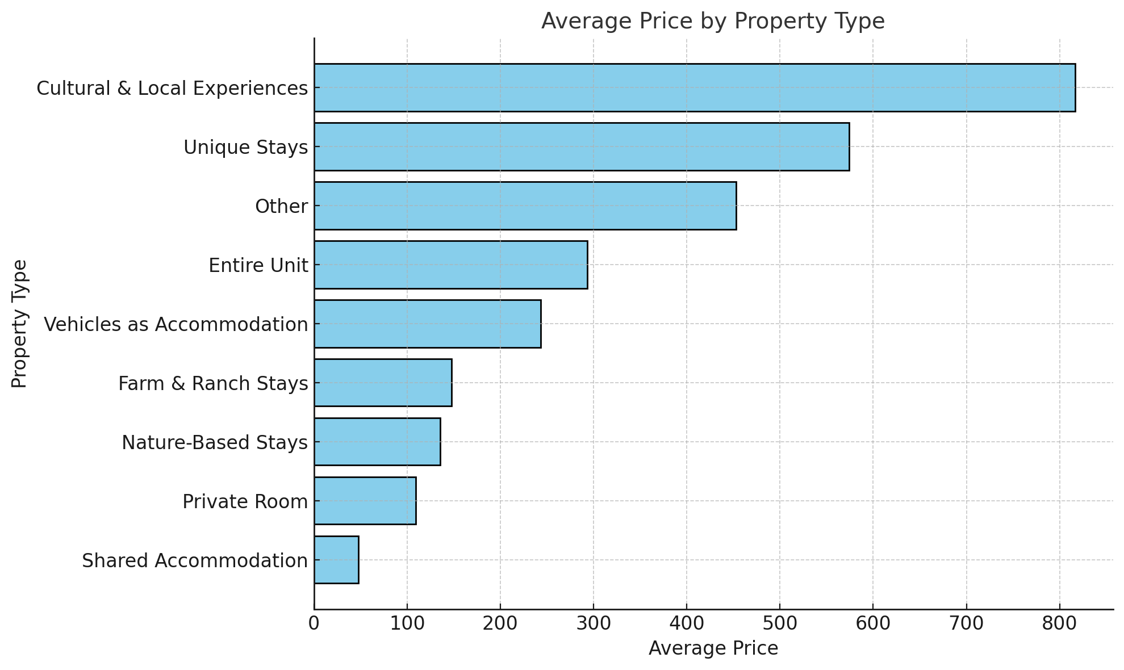
Avg price for Airbnbs with highest occupancy

Slide 15
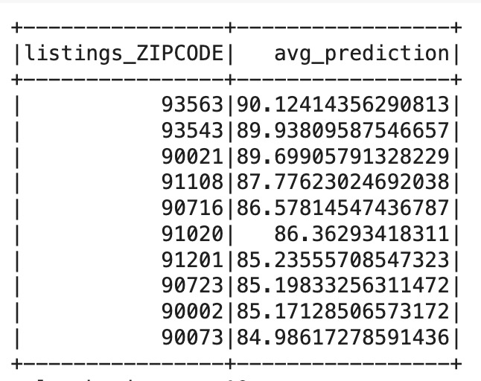
Zip Codes that have high occupancy

Slide 16
Future Scope
Simulation Analysis with front end
Use an Optimization algorithm to find the ideal pricing for an Airbnb to achieve maximum occupancy
Expand our data to include other cities

Slide 17
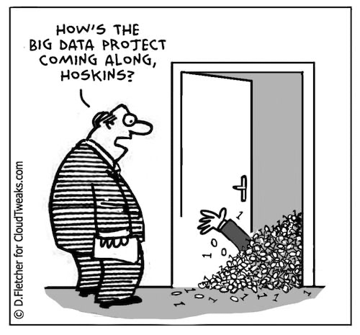
Thank You!

